Slide 1
Capstone Project 2
Sales Prediction : Predicting sales of a major store chain Rossmann
Team Members
Sumeet Agrawal
Shafil Ahamed

Slide 2
Problem Statements
Data Summary
a) Data sets b) Important Variables
c) Missing Values
Exploratory Data Analysis
a) EDA on Sales b) EDA on Store types
c) Assortment d) Customers e) Promo
f) EDA on School and State Holidays
Feature Engineering
a) Removing Nan Values
b) Correlation, c) Multicollinearity
Model Formulation
Challenges
Conclusion
Contents

Slide 3
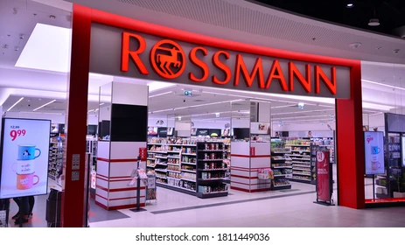
Problem Statement
Rossmann operates over 3,000 drug stores in 7 European countries. Currently, Rossmann store managers are tasked with predicting their daily sales for up to six weeks in advance.
The objective of the project is to come with a machine learning model to predict sales.
Img. Source - Google

Slide 4
Data Summary
There are two Datasets present . They are :-
Rossmann Stores Data.csv - Historical data including Sales.
store.csv - Supplemental information about the stores.

Slide 5
Details of Data Set provided :-
Sr. No. | Data Set | Variables | No. of variables | No. of observation
01 | Rossmann Store Data | store, day of week, date, sales,customers, open, promo, state holiday, school holiday | 9 | 1017209
02 | Store | store, storetype, assortment, competition distance, competition open since month, promo2, promo2since week, promo2since year, promo interval | 10 | 1115

Slide 6
Important Variables
1. Sales - The turnover for any given day (this is what we are predicting).
2. Open - An indicator for whether the store was open or closed. 0 = closed, 1 = open.
3. Store type - Differentiates between 4 different store models (a, b, c & d).
4. Assortment - Describes an assortment level: a = basic, b = extra, c = extended.
5. Promo - Indicates whether a store is running a promo on that day
6. Promo2 - Promo2 is a continuing and consecutive promotion for some stores.

Slide 7
Contd...
7. Store - A unique Id for each store.
8. Customer - The number of customers on a given day.
9. Competition Distance - Distance in meters to the nearest competitor store.
10. Promo Interval - Describes the consecutive intervals Promo2 is started, naming the months the promotion is started a new.
11. Promo2Since [Year/week] - Describes the year and calendar week when the store started participating in Promo2.
.

Slide 8
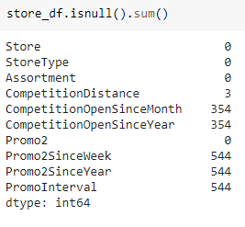
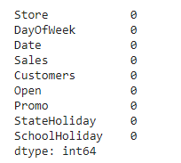
Missing Values
Looking for missing values in Store.csv
.
Looking for missing values in Rossmann.csv

Slide 9
Exploratory Data Analysis

Slide 10
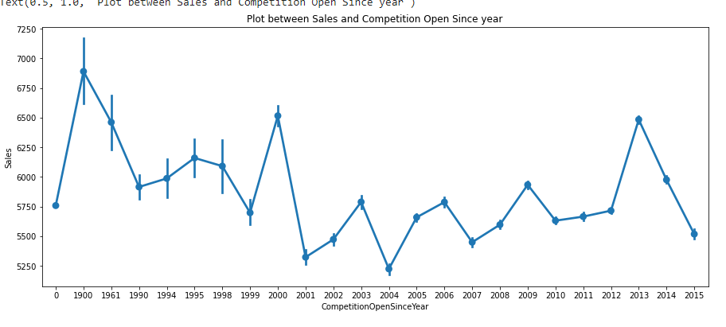
Sales vs Competition Open Since Year

Slide 11
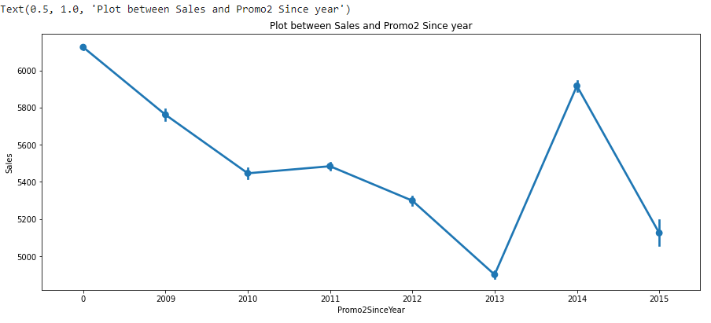
Sales vs Promo2 Since Year

Slide 12
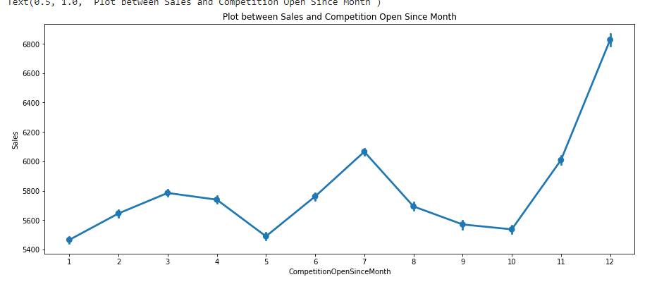
Sales vs Competition Open Since Month

Slide 13
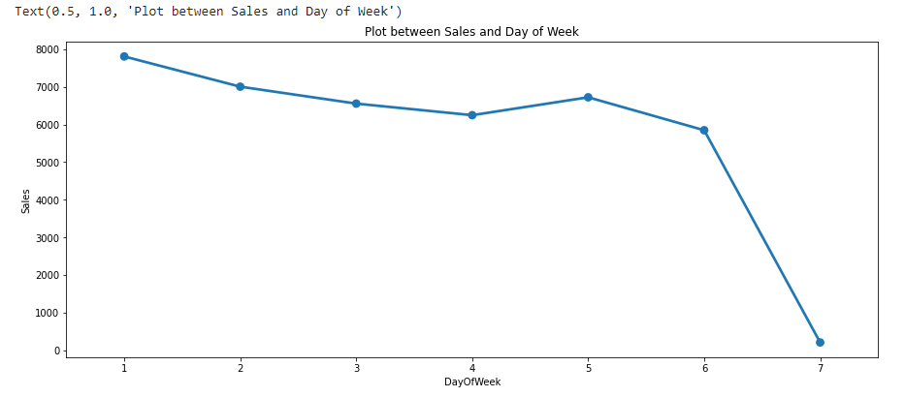
Sales vs day of Week

Slide 14
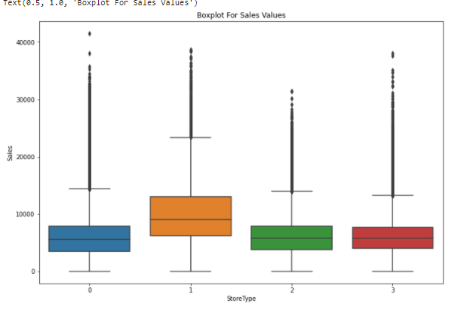
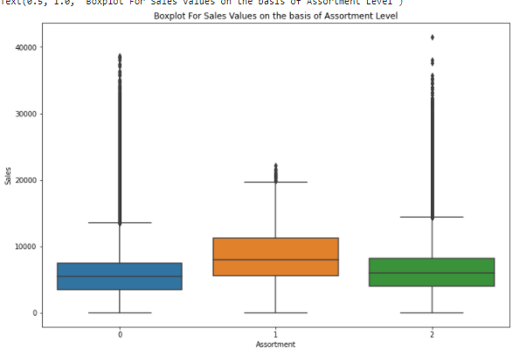
Box Plot of Sales at different Stores & Assortment

Slide 15
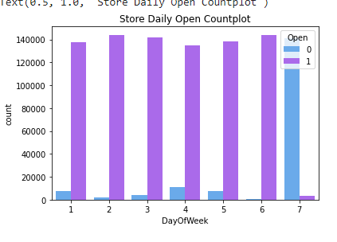
Count Plot of Stores open different day of week
0 - Closed
1 - Open

Slide 16
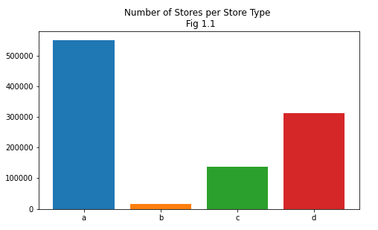
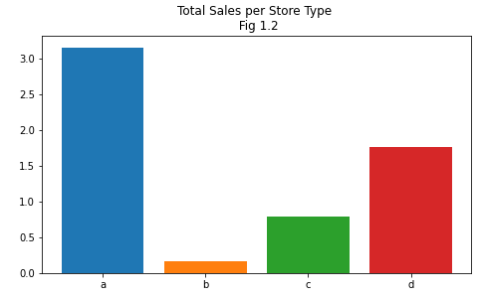
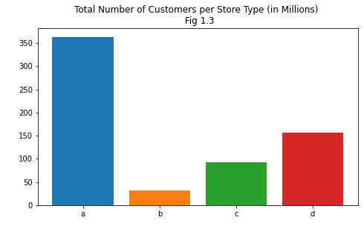
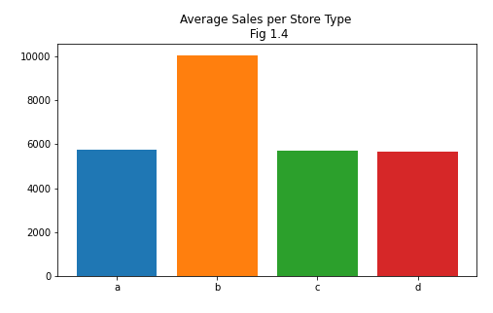
Analysis of Store Type

Slide 17
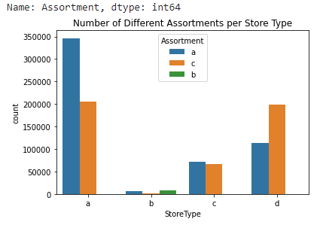
Analysis of Assortment
a - basic things
b - extra things
c - extended things
so highest variety
of products.
Notes:
Matches won and no of 200+ scores

Slide 18
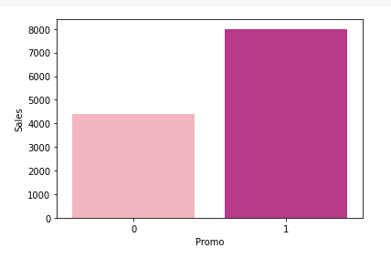
Effect of Promo on Sales
0 - Stores not
participating
1 - Stores participating
Notes:
Matches won and no of 200+ scores

Slide 19
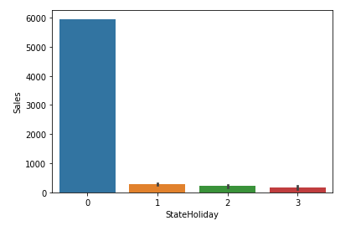
Effect of Sales on State Holidays
0 - Public Holidays
1 - Easter Holidays
2 - Christmas
3 - None
Notes:
Matches won and no of 200+ scores

Slide 20
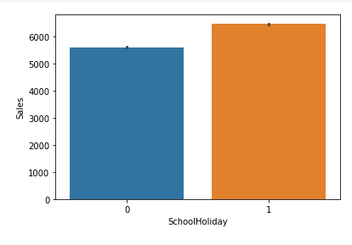
Effect of Sales on School Holidays
0 - Not Holiday
1 - School Holidays
Notes:
Matches won and no of 200+ scores

Slide 21
Feature Engineering

Slide 22
Replacing Missing values
In Store Dataset there are many Nan values.
In Competition Distance there are only 3 Nan value, so we replace with it median.
For rest other features there are lots of missing values and nothing much information giving about them.
Also we observed that for feature Promo2 having 0 values for that rows these features have Nan values.
So we think that most suitable values to replace these Nan values is to replace with 0.

Slide 23
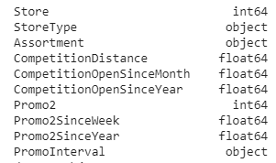
Changing data types
In Store Dataset- StoreType, Assortment and PromoInterval is of type - Object.
StoreType and Assortment have unique values - [a,b,c,d] and [a,b,c] respectively.
So we changed these to numerical [0,1,2,3] and [0,1,2] respectively.
For PromoInterval has unique value - [jan,apr,jul,oct , feb,may,aug,nov, mar,jun,sep,dec]
So we changed into dummies features.

Slide 24
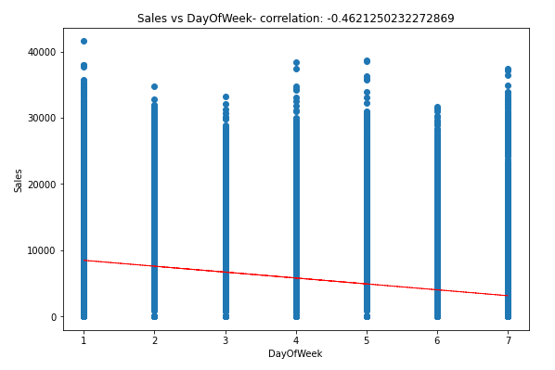
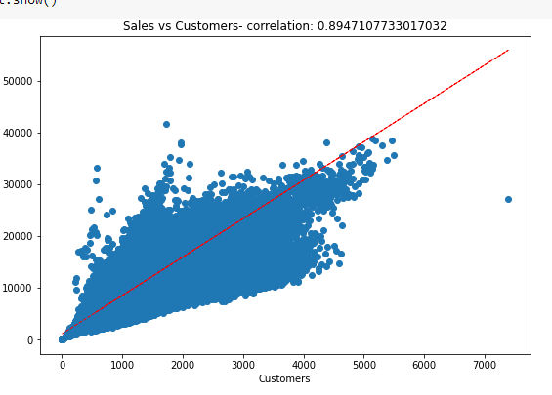
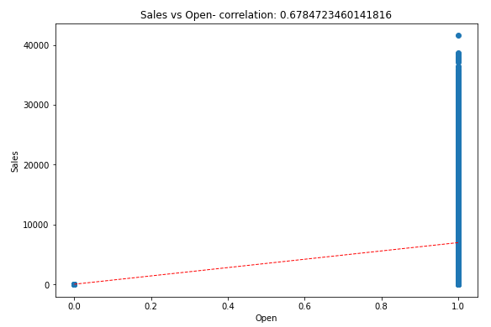
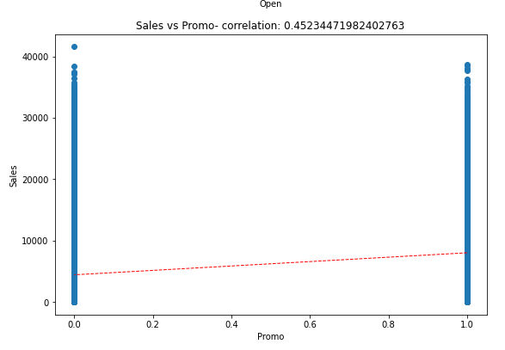
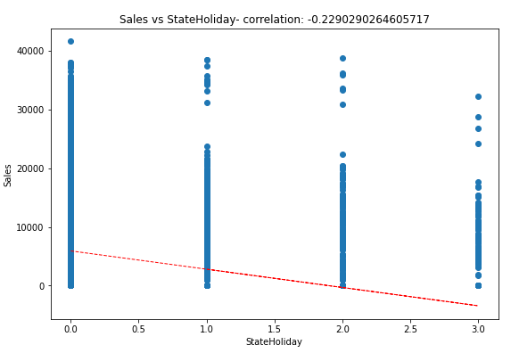
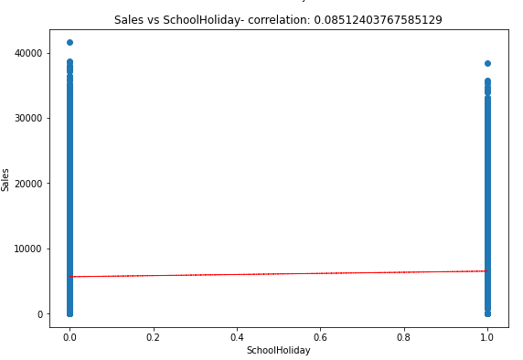
Correlation between Independent Features and Sales

Slide 25
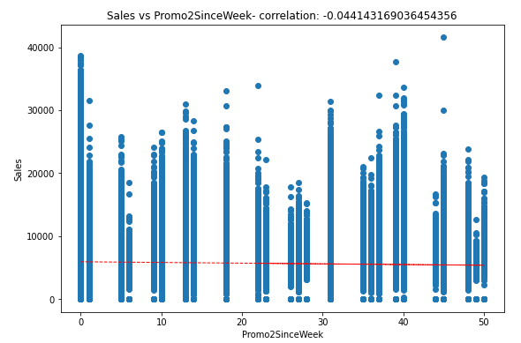
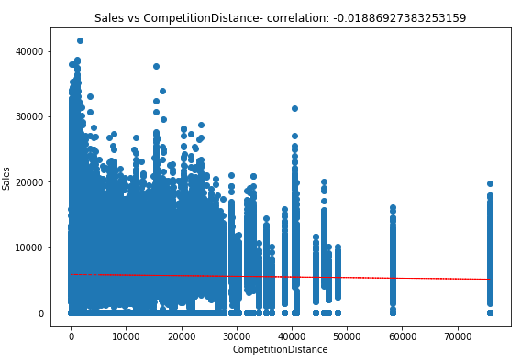
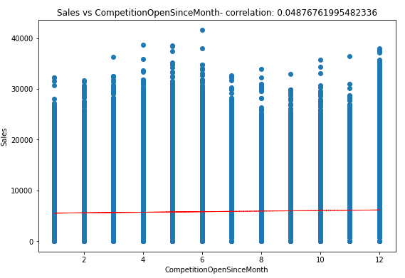
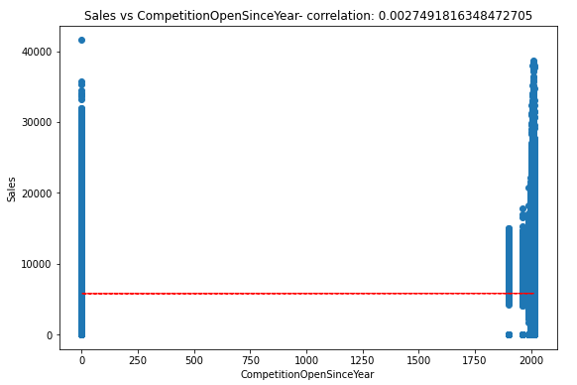
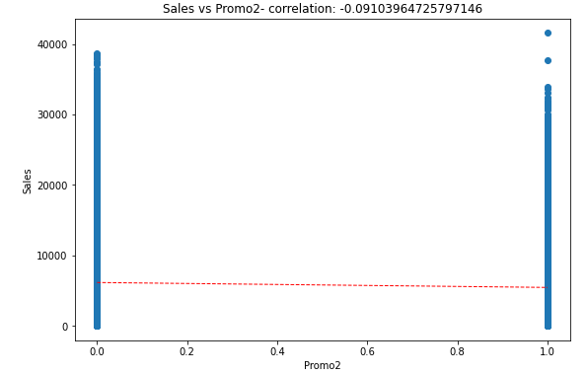
Contd..

Slide 26
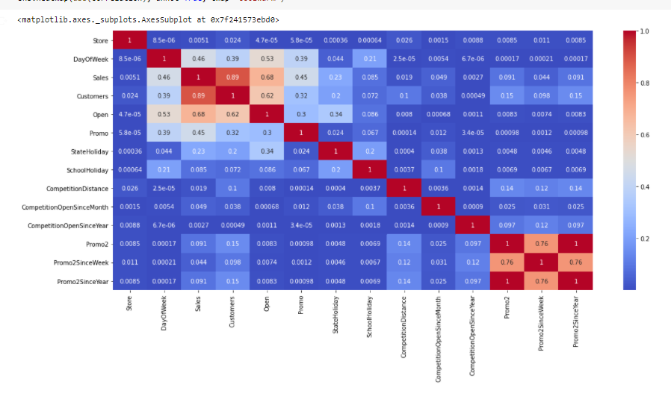
Correlation Heatmap

Slide 27
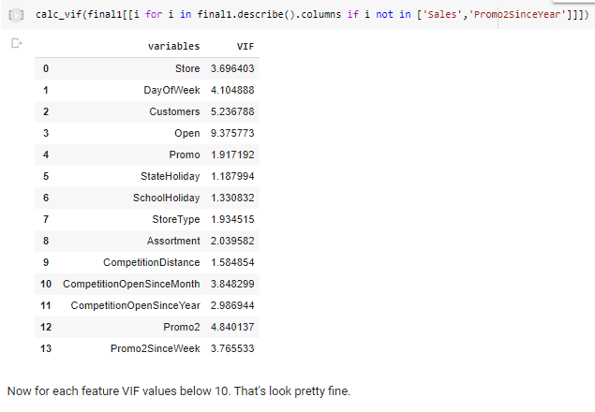
Multicollinearity

Slide 28
Model Formulation

Slide 29
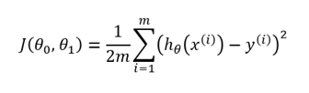

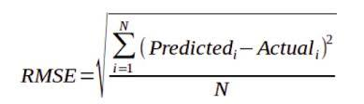

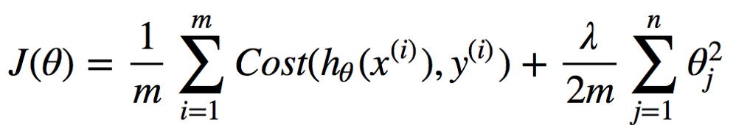
Important Formulae
Sr. No. | Functions | Formulae
01 | Cost Function
02 | R Square
03 | RMSE
04 | Lasso
05 | Ridge

Slide 30
Model
Sr. No. | Model | Dataset Shape | Algorithm Used
01 | Model 1 - Sales values = 0 rows are removed | (844392, 18) | Linear Regression, Lasso and Ridge,Decision Tree
02 | Model 2 - complete dataset taken (Sales = 0 rows also considered) | (1017208,18) | Linear Regression, Decision Tree, Random forest and Light GBM

Slide 31
MSE , RMSE, RMPSE & R2 values
From above table we can clearly say that Random Forest(Model 2 - highlighted column) has best result.
 | Model 1 |  |  | Model 2
 | Linear regression | Decision Tree | Lasso | Linear regression | Decision Tree | Random Forest | Ridge
RMSE | 1505.1518 | 1416.4939 | 1505.1599 | 1395.0635 | 1393.1978 | 1057.8482 | 1395.0632
RMPSE | 0.2606 | 0.2453 | 0.2606 | 0.2416 | 0.2412 | 0.1831 | 0.2416
R2 | 0.7634 | 0.7905 | 0.7634 | 0.8680 | 0.8683 | 0.9241 | 0.8680

Slide 32
Selection of Model
By looking both Model MSE, RMSE, RMPSE and R2 values we decided to go with 2nd Model in which took whole dataset are present.
Also in 2nd Model we did various Algorithms such as Decision Tree, Random Forest , Linear regression, Ridge and Lasso.
But above all algorithms we get very good result in Random Forest Algorithm.
So we decided to choose Random Forest Algorithm of second model.

Slide 33
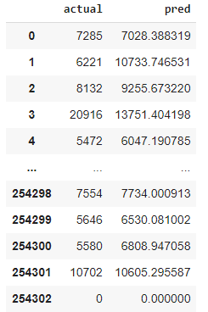
Random Forest - Actual vs Predicted

Slide 34
Challenges
Handling large amount of sales data (10,17,210 observations on 13 variables)
Some stores were closed. Unable to fill the gap of sales for those stores.
Replacing the Nan values, as there were alot of Nan values we had a challenge with what to replace it either with zero, median or mode.
Converting columns with categorical variables to integer type for regression.
Choosing right kind of model.

Slide 35
Conclusions
From plot sales and competition Open Since Month shows sales go increasing from November and highest in month December.
From plot Sales and day of week, Sales highest on Monday and start declining from Tuesday to Saturday and on Sunday Sales almost near to Zero.
Plot between Promotion and Sales shows that promotion helps in increasing Sales.
Type of Store plays an important role in opening pattern of stores. All Type ‘b’ stores never closed except for refurbishment or other reason.

Slide 36
Contd..
All Type ‘b’ stores have comparatively higher sales and it mostly constant with peaks appears on weekends.
Assortment Level ‘b’ is only offered at Store Type ‘b’.
We can observe that most of the stores remain closed during State Holidays. But it is interesting to note that the number of stores opened during School Holidays were more than that were opened during State Holidays.

Slide 37
THANK YOU

